Slide 1
Hyper-Personalisation using Gen-AI
Team Algonauts
Tejas Muralikrishnan
Shreya S
Ananya Chandrasekaran
Srinidhi Chandrasekaran

Slide 2


Problem Statement
In today's fast-evolving financial landscape, customers expect personalized experiences that cater to their unique preferences, behaviors, and financial goals. However, traditional recommendation systems often fail to deliver accurate and meaningful suggestions, leading to reduced customer engagement and missed business opportunities.
The challenge is to develop a Generative AI-powered solution that effectively analyzes diverse data sources — including customer demographics, sentiment data, purchase history, and behavioral profiles — to deliver hyper-personalized recommendations for financial products and services.
This solution must not only generate tailored suggestions but also provide actionable insights to help businesses enhance customer engagement strategies, improve product positioning, and foster stronger client relationships.

Slide 3
Our Approach
Customers had the option to explore recommended products and submit reviews. These reviews were analyzed using a Logistic Regression-based sentiment analysis model to classify them as positive or negative. This feedback loop further refined the recommendation system by capturing user preferences and satisfaction levels.
For admins, we integrated the Gemini Pro API to generate customer insights. This advanced LLM model provided detailed explanations on why specific financial products were recommended, ensuring transparency and trust. The insights were generated based on a combination of customer behavior, risk profile, and financial patterns.

Slide 4
Our Approach
Our approach to building a hyper-personalized financial recommendation system involved integrating machine learning models, secure architecture, and data-driven insights.
We began by constructing a comprehensive database comprising demographic data, financial behavior, and transactional data. To ensure realistic representation, this data was synthetically generated and designed to reflect diverse customer profiles.

Slide 5
Our Approach
To assess customer risk, we employed a robust ensemble approach by leveraging RandomForest, Logistic Regression, and XGBoost. Hyperparameter tuning was performed using RandomizedSearchCV to optimize model performance. Each model's performance was evaluated, and the best-performing model was selected to predict the customer's risk level. This risk assessment enabled us to segment users into low, medium, or high-risk categories.
Based on the identified risk profile, personalized financial products were recommended to each customer. This ensured that risk-averse users received safer financial options, while risk-tolerant users were presented with higher-yield opportunities.
The platform was designed with distinct user roles: admin and customer. Role-Based Access Control (RBAC) was implemented using JWT tokens to ensure secure authentication and authorization. Customers could sign up or log in to access their profile, transaction history, and financial status.

Slide 6
Our Approach
Customers had the option to explore recommended products and submit reviews. These reviews were analyzed using a Logistic Regression-based sentiment analysis model to classify them as positive or negative. This feedback loop further refined the recommendation system by capturing user preferences and satisfaction levels.
For admins, we integrated the Gemini Pro API to generate customer insights. This advanced LLM model provided detailed explanations on why specific financial products were recommended, ensuring transparency and trust. The insights were generated based on a combination of customer behavior, risk profile, and financial patterns.

Slide 7
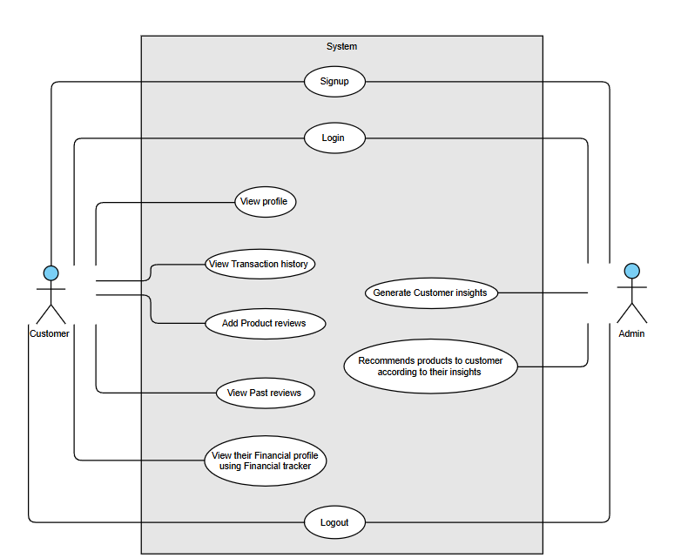
User Functionalities

Slide 8
Architecture Diagram
Risk Profile
Financial Behavior
Transactions
Reviews
Demographic Details
AI Classifier
Feature Extraction
Train dataset
Models
LR
RF
XGBoost
SVM
Risk Prediction Model
Best
LLM(Gemini)
To generate insights
and
recommendations
model
Hyper Parameter Tuning

Slide 9
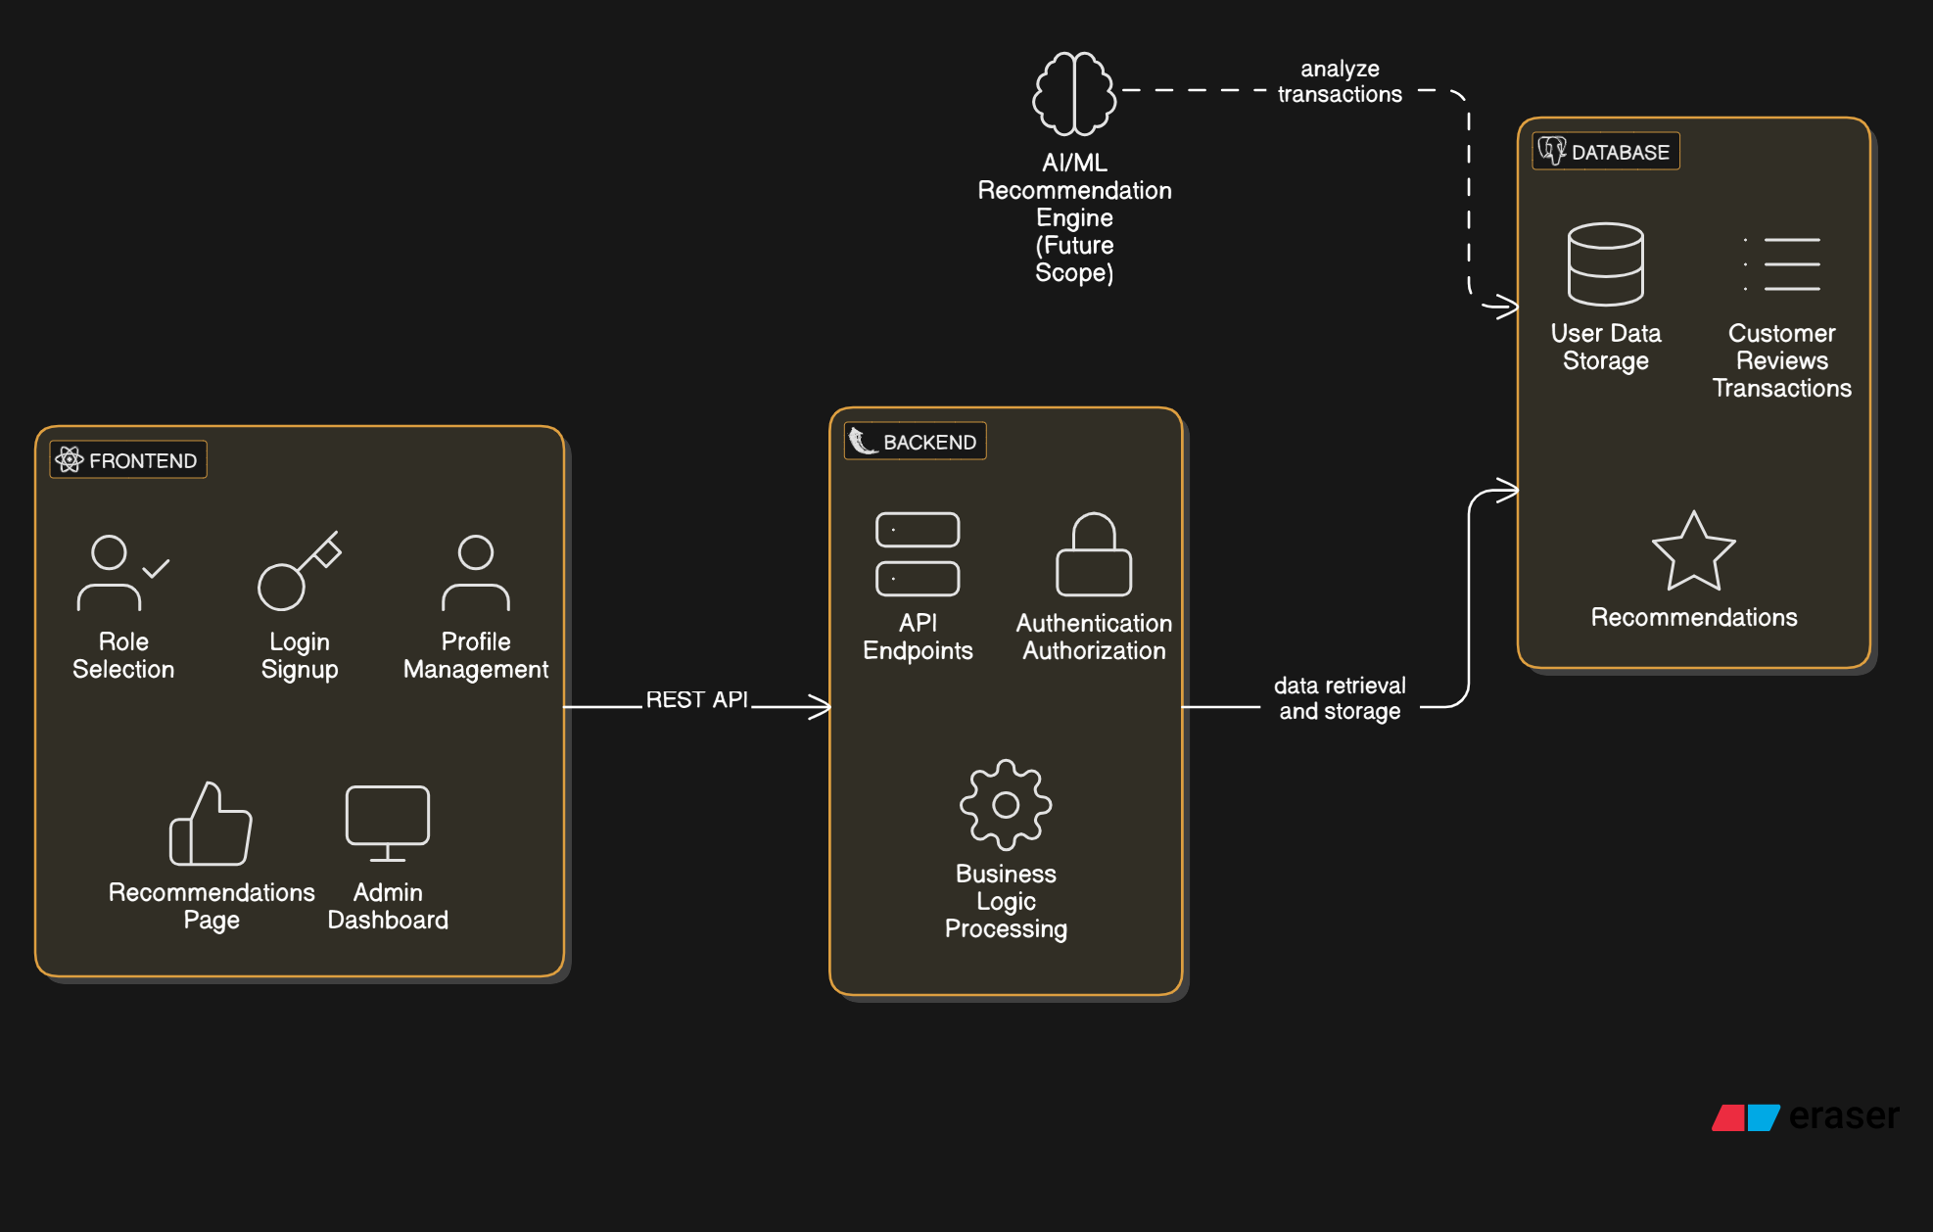
System Architecture Diagram

Slide 10
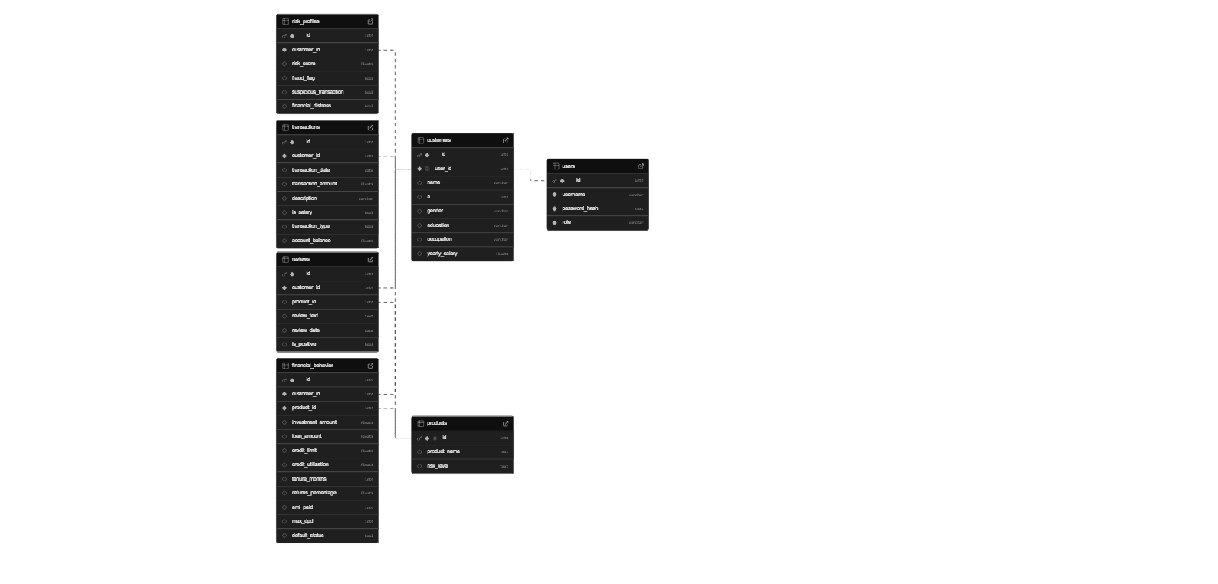
DataBase Schema

Slide 11
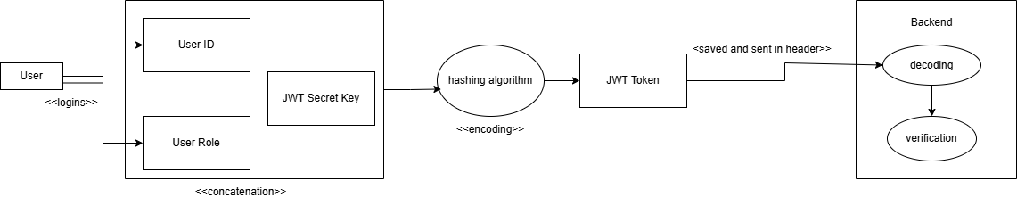
Authentication and RBAC
Using JWT secret key, an encrypted JWT token is created that is passed from the frontend via header. After receiving the token, it is decrypted and verified as a user (either customer or admin)

Slide 12
Challenges Faced
Financial data often contains inconsistencies, missing values, and outliers, requiring extensive preprocessing to ensure data integrity.
Encouraging users to trust and rely on AI-driven financial insights requires a transparent, user-centric design with demonstrable value.
Customer preferences, financial products, and market dynamics change rapidly. Ensuring the model remains up-to-date through continuous learning pipelines is crucial for sustained performance.
Striking a balance between enhancing customer engagement and achieving organizational goals, such as cross-selling or upselling, requires thoughtful strategy.

Slide 13
Model Evaluation
Review Classification:
Metric | Class 0 (Negative) | Class 1 (Positive) | Accuracy | Macro Avg | Weighted Avg
Precision | 0.91 | 0.96 | - | 0.94 | 0.95
Recall | 0.88 | 0.97 | - | 0.93 | 0.95
F1-score | 0.90 | 0.97 | 0.95 | 0.93 | 0.95
Support | 15,634 | 46,020 | 61,654 | 61,654 | 61,654
Risk Prediction:
Accuracy: 93
Recall: 91
Precision: 90

Slide 14
Future Scope
Embedding voice assistants or AI chatbots can offer users a seamless way to inquire about financial products, receive guidance, and manage transactions.
Leveraging advanced anomaly detection techniques can enhance fraud prevention, while improved risk profiling can identify vulnerable customers early and suggest proactive financial strategies.
Building transparency features that clearly explain why a particular recommendation was made will enhance user trust and support regulatory requirements.
Expanding the system to support multi-tenant architectures or cloud-based deployment can enable broader adoption across financial institutions and e-commerce platforms.

Slide 15
Thank you!

